Slide 1
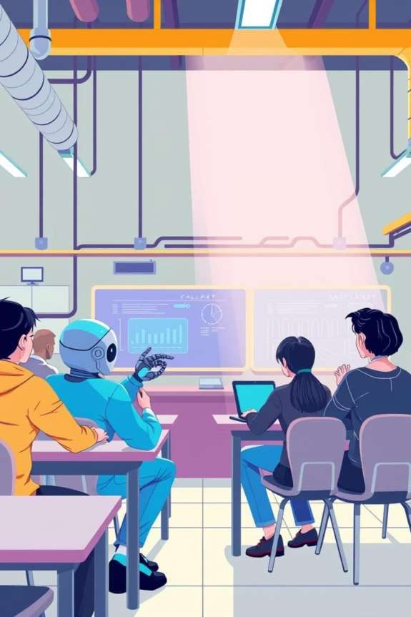
AI Mentor: Smart Companion for Every Student
Transforming Education with AI
Hackathon: Samadhan 2.0 Team: Syntax Solvers
Members: Vipin Tomar, Jayesh Thakur, Ambar Gupta

Slide 2




“Why Traditional Exam Prep Fails”
Overload of Resources
Language Barriers
Lack of Personalization
Low Motivation

Slide 3
“Reimagining Learning with AI”
Big statement with minimal bullets:
Personalized.
Accessible.
Collaborative.
Human-Centered.

Slide 4
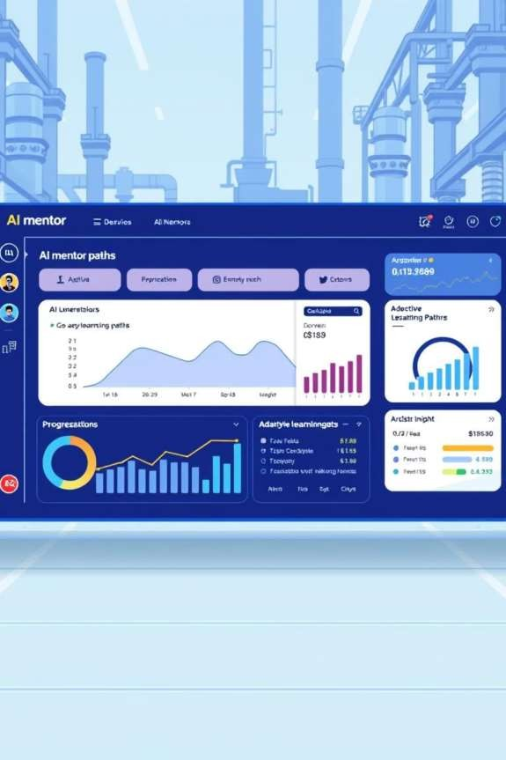
The Solution: AI Mentor
Adaptive learning paths
Bilingual support
Instant doubt solving
Progress insights
Peer learning rooms

Slide 5

How It Works (Live Demo Workflow)
Student
Asks
AI Mentor responds (bilingual, instant feedback)
Tracks progress
Connects with peers

Slide 6





Tech Stack & Architecture
Frontend
AI & Real-Time
Backend
Database

Slide 7
Core Requirements (Rule Checklist)
✅ Bilingual Voice/Text Support
✅ Multimedia Inputs (Text, Audio, PDFs)
✅ Group Collaboration
✅ Real-time Progress Tracking
✅ AI-first Integration

Slide 8
“What’s Next”
Expanding to competitive exams (GATE, CDS, UPSC).
Advanced AI analytics & emotional intelligence tutor.
Integration with schools/universities.

Slide 9
“AI Mentor = Education for Everyone, Everywhere.”

Slide 10
Thank You!
Presented by Team Syntax Solvers
Team Members: Vipin Tomar, Jayesh Thakur, Ambar Gupta

